Slide 1
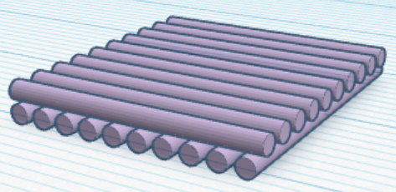
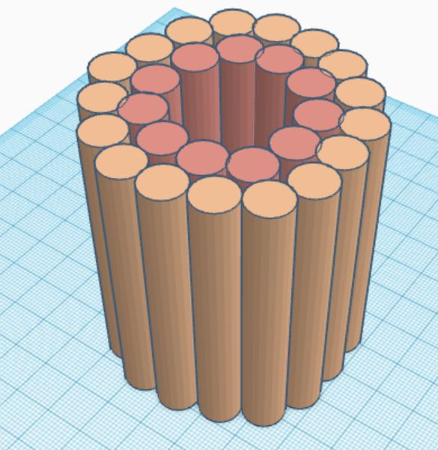
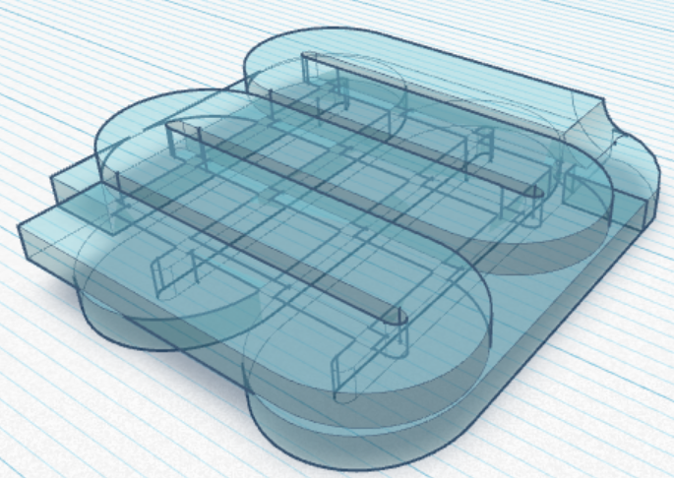
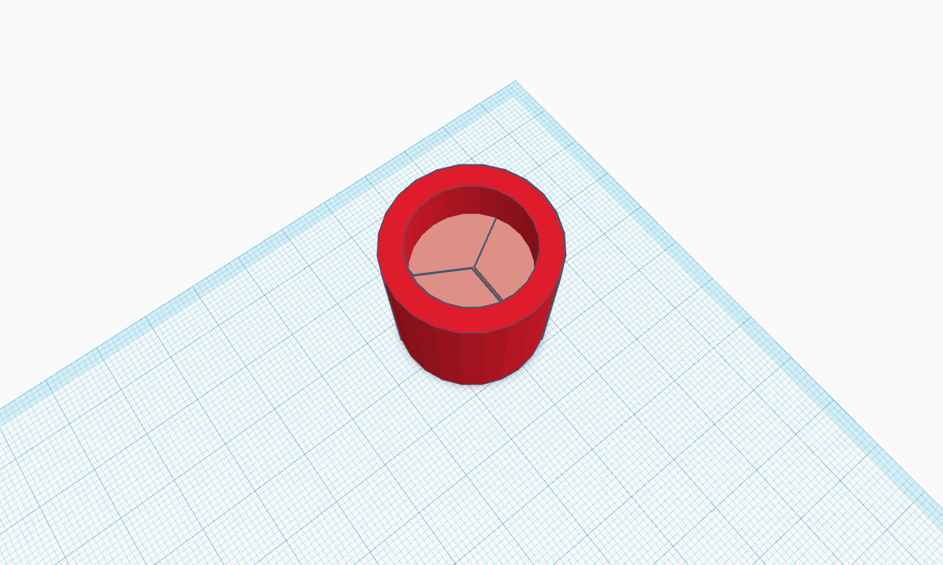
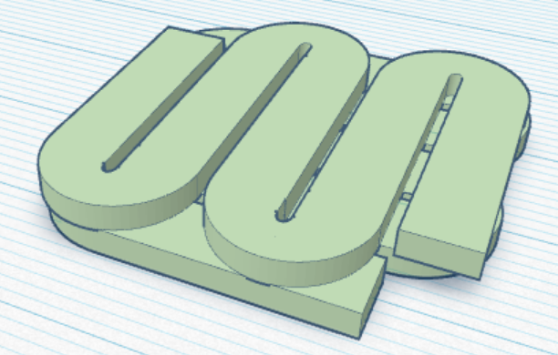
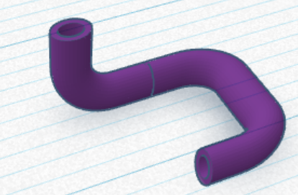
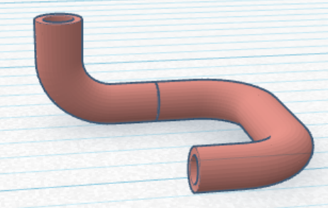
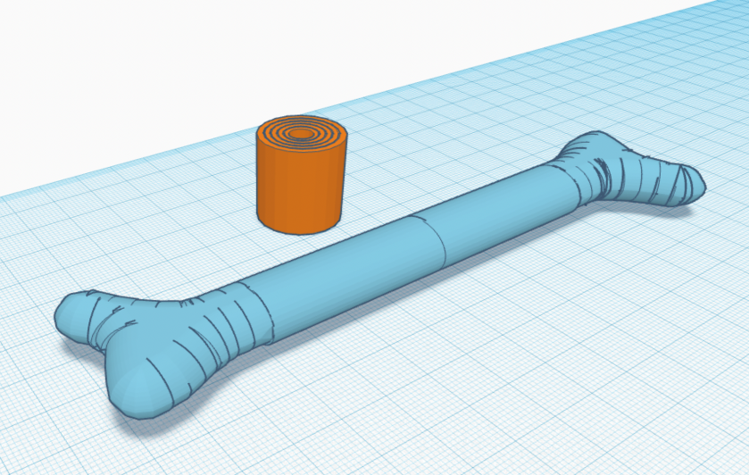
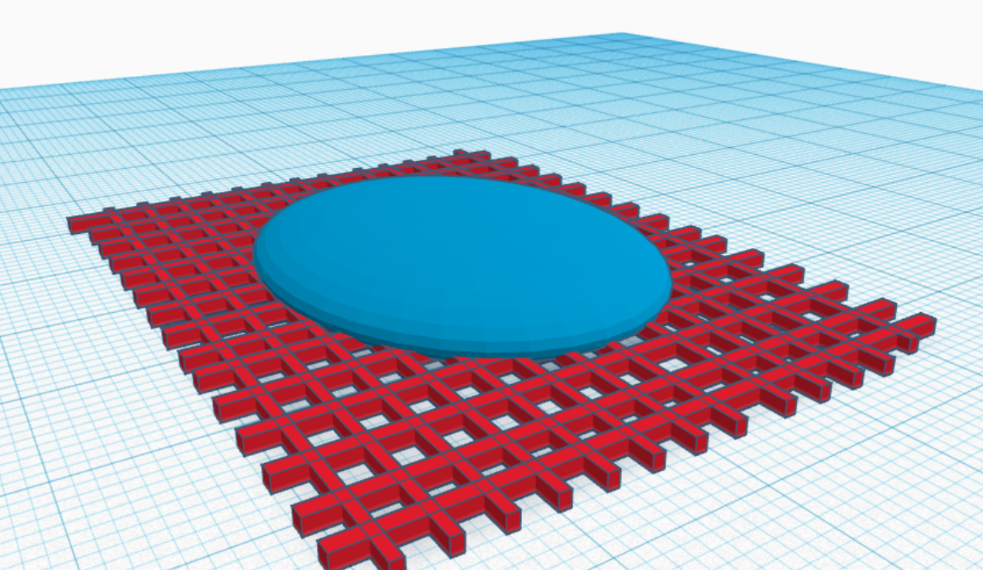
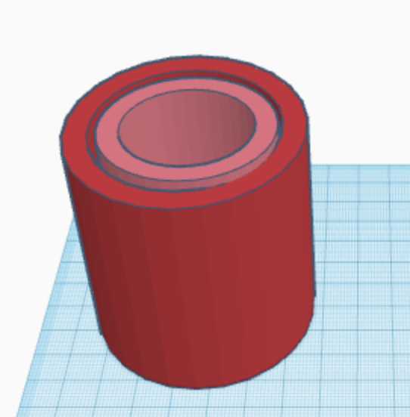

3D Bio-Printing
Group 6
Parisa Nabili, Christofer Richard, Hana Roš,
Laura Sanchis Pla, Izar Schärf, Julia Oster

Slide 2
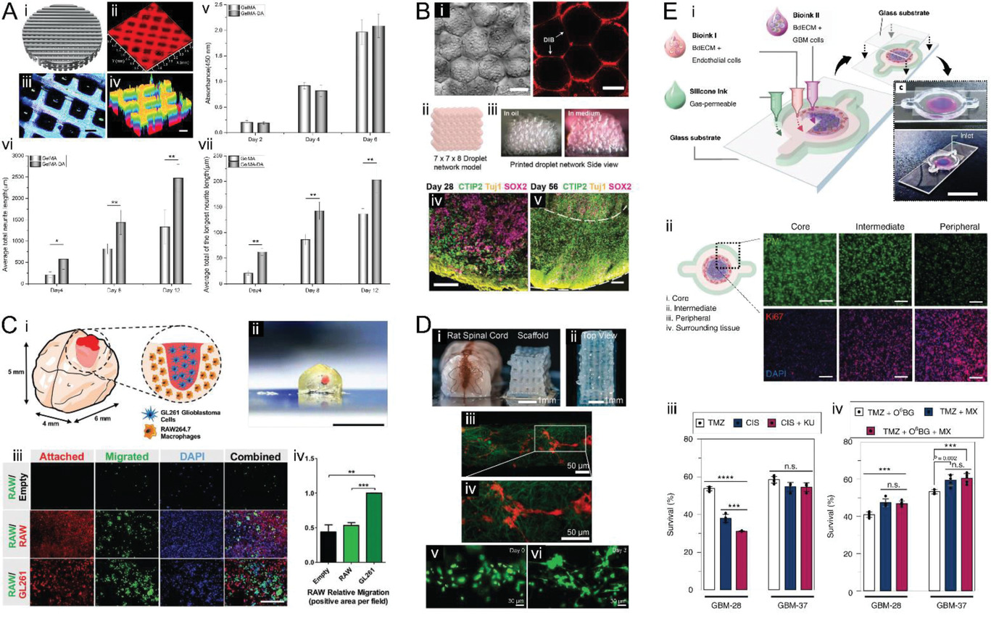
Applications of 3D Bio-Printing
Create complex 3D tissues and organs which are functional and alive
In vitro modeling
Drug screening
Regenerative medicine -> transplantation
For example: Neural Tissues
Cadena, M., et al. (2021). "3D Bioprinting of Neural Tissues."
Murphy, S. V. and A. Atala (2014). "3D bioprinting of tissues and organs."
Heinrich, Bansal et al. (2019). 3D-Bioprinted Mini-Brain: A Glioblastoma Model to Study Cellular Interactions and Therapeutics
Joung, Truong et al. (2018). 3D Printed Stem-Cell Derived Neural Progenitors Generate Spinal Cord Scaffolds

Slide 3
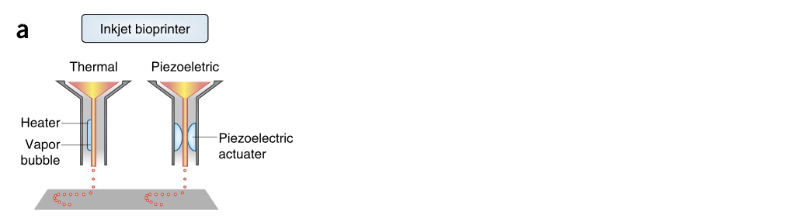

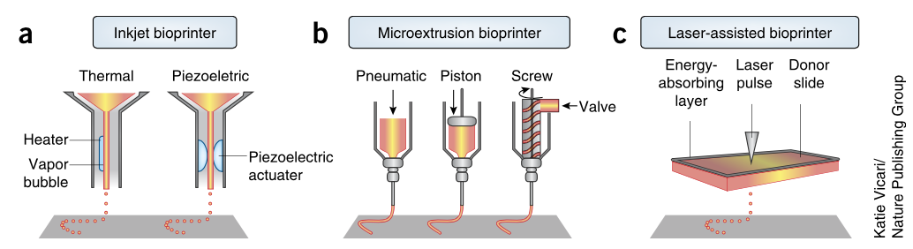

Types of bioprinting methods
Laser-assisted bioprinting
Laser used as energy source to deposit biomaterials on substrate
Laser pulse irradiates ribbon with donor biological tissue
These evaporate and reach receiving substrate as droplets
Pro: no nozzle = no clogging; Con: slow flow rate
Extrusion-based bioprinting
Biomaterials are pressed out of a nozzle
Continuous beads rather than droplets
Pneumatic or mechanical (piston or screw) dispensing systems
Pro: high cell densities and viscosities; Con: lower cell viability
Inkjet bioprinting
Non-contact printing technique
Delivers controlled volume of liquid (droplets), no continuous flow
Different methods: thermal, piezoelectric or acoustic
Pro: high printing speed; Con: low cell densities
Murphy, S. V. and A. Atala (2014). "3D bioprinting of tissues and organs."
Khoeini, R. et al. (2021). “Natural and Synthetic Bioinks for 3D Bioprinting”
Notes:
The main bioprinting methods are extrusion, inkjet and laser-assisted bioprinting.
Inkjet bioprinting is a non-contact printing technique that delivers a controlled volume of liquid (droplets) onto the subtstrate, so no continuous flow. There are different methods for the droplet formation, like thermal, piezoelectric or acoustic. A pro is its high printing speed; a con the low cell densities in the drops.
In extrusion-based bioprinting, biomaterials are pressed out of a nozzle in form of a continuous bead instead of droplets. There are pneumatic or mechanical (piston or screw) dispensing systems. A pro are the high cell densities, because high viscosities can be extruded with higher pressure; a con is the lower cell viability because of the shear stress.
Laser-assisted bioprinting uses a Laser as an energy source to deposit biomaterials on substrate. The laser pulse irradiates a ribbon with the donor biological tissue, which evaporates and reaches the receiving substrate in form of droplets. A pro is that this method has no nozzle, so no clogging; a Con is its slow flow rate.

Slide 4
Natural and synthetic bioinks
Bioinks → mimic extracellular matrix
Print temperatures under physiological temperatures
Mild cross-linking conditions
Non-toxic
Natural |  | Synthetic
Collagen | Important hydrophilic protein of ECM → high biocompatibility Integrin-binding domains → cell-adhesion Mechanical instability at physiological temperatures | Polyethylene glycol (PEG) | Variable chain length + structure (linear, branched) Strong mechanical properties Non-cytotoxic, but bioinert (needs to be combined with bioactive materials)
Gelatin | Denaturation of collagen → biocompatibility Thermosensitive: forms hydrogel at low temperatures Modified versions cross-linked by UV light (Gelatin Methacryloyl) | Pluronic | Poloxamer, used as sacrificial structure (washed away) Biocompatibility not enough for long-term cell-survival
Alginate | Anionic polysaccharide from brown seaweed Biocompatible, not cytoxic, fast and mild gelation process Cross-linked with divalent cations | Polyvinyl-pyrrolidone (PVP) | Nonionic amorphous polymer Non-toxic, water-soluble Composite scaffolds with Polycaprolactone → high cell biocompatibility
Gungor-Ozkerim, S.P. et al. (2018). Bioinks for 3D bioprinting: an overview
Benwood, C. et al (2021). Natural Biomaterials and Their Use as Bioinks for Printing Tissues
Notes:
Bioinks contain living cells and biomaterials that mimic the extracellular matrix environment. They must have:
Print temperatures under physiological temperatures
Mild cross-linking conditions
and non-toxic components
Some natural bioinks are:
Collagen, which is a very important hydrophilic protein of the ECM. That’s why it has a high biocompatibility. It has Integrin-binding domains which promote cell-adhesion. However, it is mechanically unstable at physiological temperatures, making it hard to maintain its shape.
Gelatin is obtained from the denaturation of collagen, ensuring its biocompatibility. It’s a thermosensitive bioink that forms hydrogels at low temperatures. Modified versions, like Gelatin Methacryloyl, can be cross-linked by UV light.
Alginate is an anionic polysaccharide from brown seaweed that is commonly used because it’s biocompatible, non-cytoxic, and has a fast and mild gelation process. It can be cross-linked with divalent cations, however in the long-term they might erode, affecting the stability of the gel.
Polyethylene Glycol (PEG) is a synthetic bioink with variable chain length and structure (it can be linear or branched). It’s a good material because of its strong mechanical properties and not being cytotoxic, but it’s bioinert, so it needs to be combined with bioactive material to ensure cell adhesion.
Pluronic, is a Poloxamer, a special kind of polymer that is used as a sacrificial structure. This means it will be washed away after the printing process. Its biocompatibility is not enough for long-term cell-survival.
Polyvinylpyrrolidone (PVP) is a nonionic amorphous polymer that is non-toxic and water-soluble. It has been used mostly for composite scaffolds together with Polycaprolactone, leading to a high cell biocompatibility.

Slide 5
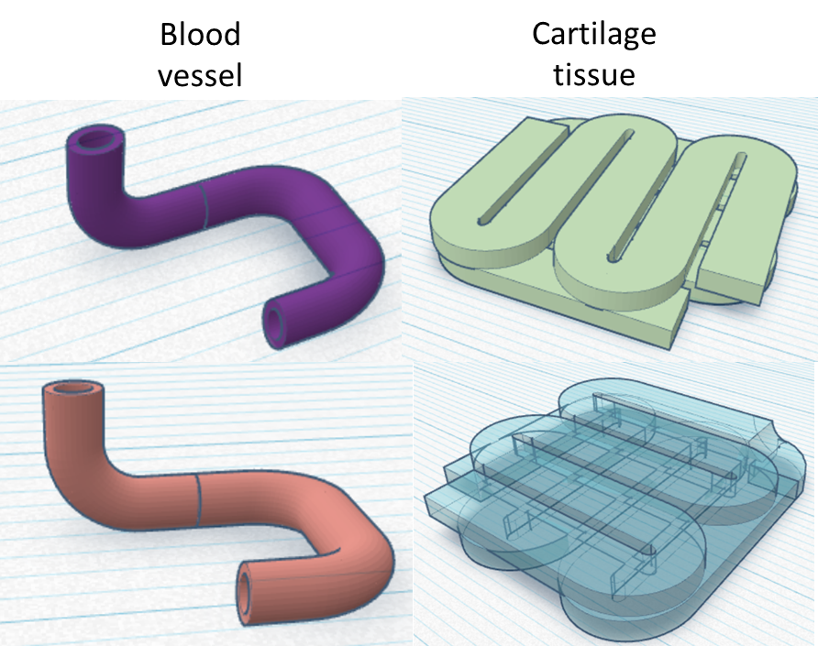

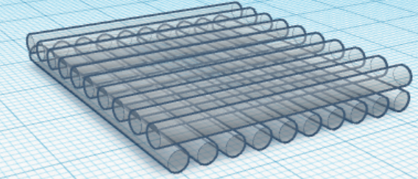
3D structures
Tubes for renal tubular tissue
Bone and osteon
Renal tissue: Singh, N. K. et al. (2020). Three-dimensional cell-printing of advanced renal tubular tissue analogue.
Bone: https://all3dp.com/doctors-3d-print-bone-implants-mid-surgery/
Blood vessel
https://www.sciencedirect.com/science/article/pii/B9780081011034000181
https://www.researchgate.net/figure/Zonal-property-of-native-cartilage-and-current-3D-printing-approaches-for-cartilage_fig2_310784277
Artificial lens
Integration
Generic
scaffold
Aortic valve
Hussein, N. et al. (2020). Simulation of semilunar valve function: computer-aided design, 3D printing and flow assessment with MR
Earnest P. et al (2021): 3D Bioprinting of Vascularized Tissues for in vitro and in vivo Applications
Notes:
Intro: With using the help of 3D design softwares such as TinkerCAD, these simple structures relevant for biological applications were made.
Hana: Cartilage diseases are very common and can lead to pain or loss of function for the patient, often degenerating into osteoarthritis of the joint. As the human body usually cannot completely regenerate the damaged cartilage, external implants are often needed. Due to its layered structure, cartilage can be 3D printed effectively. The design example in the upper right corner shows two of these layers.
Christofer: Aside from cartilages, bones are also crucial connective tissues in the skeletal system. The bone is a complex structure made up of osteoblasts, osteoclasts, blood vessels, etc. In case of an irreparable bone fracture, new bones can be created as a replacement with the help of 3D printing.
Izar: The potential application of the artificial lens surrounded by a bioprinted framework is to allow an artificial gelatinous lens to be integrated into the eye seamlessly with muscle cells and connective tissue being able to populate the frame and make the modulation of the tension on the lens and thereby the focus of the lens possible.

Slide 6
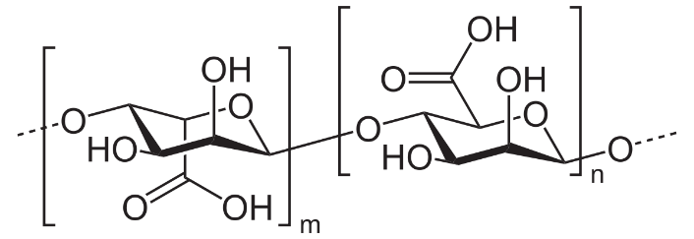
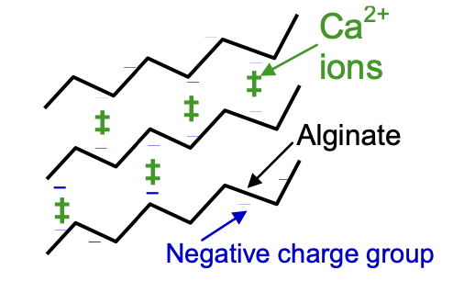
Bio-Ink Synthesis
How much alginate was used in generating a 2% (PD02) and 4% (PD03a) w/v solution in mg?
6 mL H₂O → [% alginate] * 6 / 100 → 120 mg and 240 mg respectively
What process occurs when calcium chloride is added to the alginate?
Crosslinking
Alginate polymers (C₆H₇NaO₆)_{n}
Linked with Ca²⁺ → Gel bead
Na(Alginate) + CaCl₂ → 2 NaCl + Ca(Alginate)
https://omsi.edu/sites/all/FTP/files/chemistry/U3JellyBeads.pdf

Slide 7
Bio-Ink Synthesis
3.2 Q3:
As [alginate] increases so does viscosity
Factors: MW, polymer length, H-bonds, Hydrophobic interactions, VdW, enthalpy of complexation, specific heat capacity
Initial viscosity is similar to static friction, as energy is added to the system friction decreases
Dual impact of methylcellulose depending on distribution/homogeneity of gel
Fibre-formation based on hydrophobic interaction -> gives stiff structure
Disruption of Ca2+ complexation in homogenous gel
3.2 Q4:
G’(PDO2C) = 2.5 * 10⁴ [Pa] G’(PDO3C) = 0.8 * 104 [Pa]
G”(PDO2C) = 0.4 * 10⁴ [Pa] G”(PDO3C) = 0.12 * 104 [Pa]
G (PDO2C) = 25317,9778 = 2.5 *10⁴[Pa] G(PDO3C) = 8089.49 =0.8 * 10⁴[Pa]

Slide 8
Bio-Ink Synthesis
5.) What are the major advantages using hydrogels over solid polymeric structures (i.e., materials such as polydimethylsiloxane) for bio applications?
High water content
Porosity
Soft consistency
Flexibility
Increased biocompatibility
PDMS (Polydimethylsiloxane): can absorb small hydrophobic molecules (biomolecules or drugs) from the solution.

Slide 9
Bio-Ink Synthesis
6.) What is the role of Methylcellulose in generating a bio-ink?
• Polar Methylcellulose: high binding affinity to water molecules in aqueous solutions.
• Allows formation of highly viscous hydrogel networks.
• Enhanced viscosity of alginate solution --> increased printability

Slide 10
Cell Mixing
Step 1: Cell suspension preparation
Remove medium from culture flasks and wash flasks with PBS to remove any excess medium or other residues.
Remove PBS and add detaching agent. Check if cells have detached completely from flask by observing under the microscope.
Transfer cell suspension into a tube with medium. Centrifuge and remove supernatant.
Resuspend pellet with medium using a pipette, then add more medium to tubes.
Count cells and transfer needed amount to new tubes. Centrifuge again and remove supernatant.
Resuspend pellet with medium by pipetting up and down. Note that the amount of medium added should be equal to 10% of the total bioink volume.

Slide 11
Step 2: Cell mixing with bioink
Add cell suspension to a syringe by pulling the pistol while injecting the suspension. Make sure there is no air in the syringe.
Attach a luer lock female on the syringe and connect the syringe containing the bioink.
To homogenize cells in the bioink, mix back and forth between the two syringes.
Remove air bubbles by gently tapping on the syringe. Make sure there is no air in the syringe.
Step 3: Transfer into cartridges
Adapt volume in cartridges depending on the expected amount of bioink to be used.
Fix syringe and cartridge with a female luer lock.
Load cartridge

Slide 12
Calibration
Please explain why calibration is important and explain the effect it can have on downstream processing on tissue engineering purposes.
How can the viscosity of bio-inks affect the pressure required to extrude the material?
Reproducibility
Comparability
Different structure than intended
Results of further research may not represent biological reality
Structure that does not fit
The more viscous the bio-ink is, the more pressure is needed to get a constant stream.

Slide 13
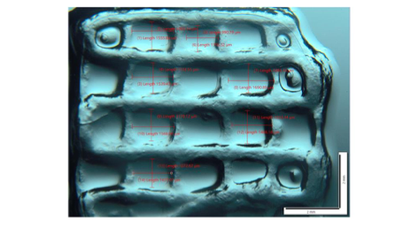
Further questions
Describe the characteristics of the printed structures of PD02.
Physical appearance
Looks stiffer, more rigid, the grid form has been maintained
Chemical explanation
Higher alginate and methylcellulose concentration, therefore the bioink has a higher viscosity
The more viscous, the more pressure needed to bring ink out (more stress on cells, loss of viability)
On the other hand, it maintains its shape better

Slide 14
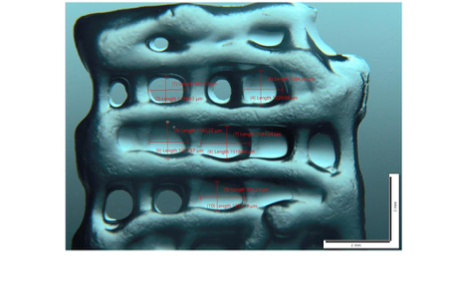
Further questions
Describe the characteristics of the printed structures of PD03a.
Physical appearance
Borders are rounded, the grid form not really maintained, bioink seems less viscous
Chemical explanation
Lower alginate and methylcellulose concentration, so the viscosity of the bioink is lower
Less pressure needed to bring ink out, but the ink doesn’t hold the shape as nicely
Less resolution

Slide 15
Further questions
What can be adjusted to increase the bioprint resolution?
Resolution → smallest printed material unit (strand of drops)
Higher the alginate and methylcellulose concentration → Higher viscosity
Smaller droplets, better resolution
Other printing parameters: printing path height and space (layer thickness), nozzle diameter
Smaller nozzle, higher pressure → higher resolution
Risk of clogging and excessive shear stress → lower cell viability
Improved with shear thinning materials that reduce shear flow resistance
Fast printing speed → most important kinematics factor
Equilibrium between viscosity and pressure
Lee, J.M. et al. (2019). Resolution and shape in bioprinting: Strategizing towards complex tissue and organ printing
Miri, A.K. et al (2019). Effective bioprinting resolution in tissue model fabrication
Notes:
Resolution depends on the smallest material unit being printed
For extrusion, it’s a strand of drops
The higher the alginate and methylcellulose concentration, the higher the viscosity, leading to droplets with a smaller diameter, and therefore better resolution
Resolution also depends on layer thickness, which is affected by printing parameters like printing path height, path space and nozzle diameters
The smaller the nozzle and the higher the pressure, the higher the resolution, however the risk of clogging is bigger, as well as of excessive shear stress, leading to lower cell viability
Therefore, an equilibrium between viscosity and pressure is necessary

Slide 16
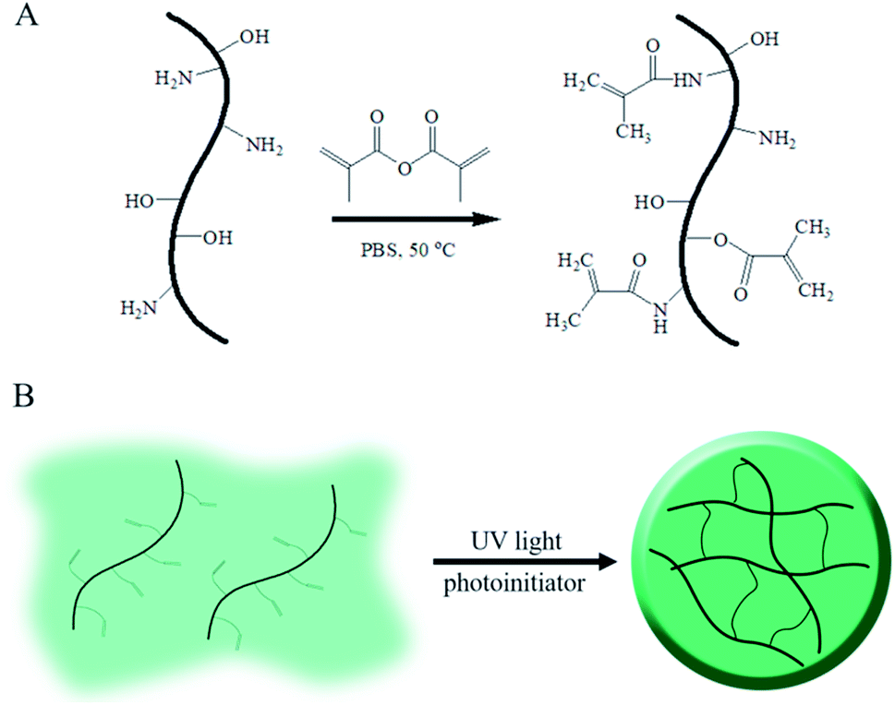
Further questions
The system PD06 contains gelatine methacrylate (GelMA) , why may this increase resolution of the system and cause changes in structure/function?
GelMA → gelatin modified with methacryloyl groups (photopolymerizable)
Fast covalent cross-linking by a photoinitiator and UV light
Easy control of cross-linking density, which affects bioprint stiffness
Higher concentrations lead to
faster gelation speed,
preservation of integrity and high mechanical strength
→ explains overall higher resolution
Dong, Z. et al. (2019). Gelatin methacryloyl (GelMA)-based biomaterials for bone regeneration
Gungor-Ozkerim, S.P. et al. (2018). Bioinks for 3D bioprinting: an overview
Benwood, C. et al (2021). Natural Biomaterials and Their Use as Bioinks for Printing Tissues

Slide 17
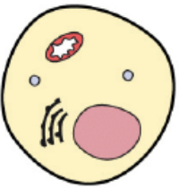
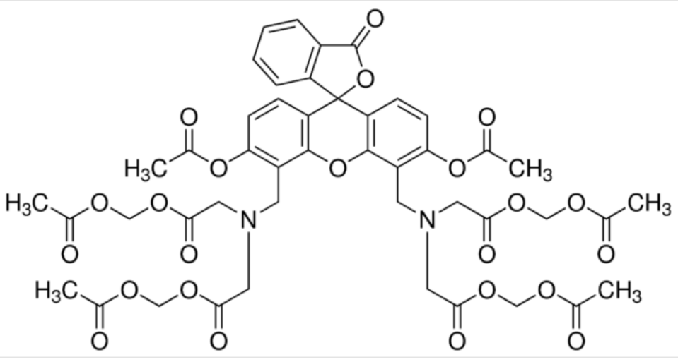
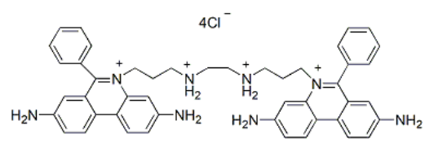
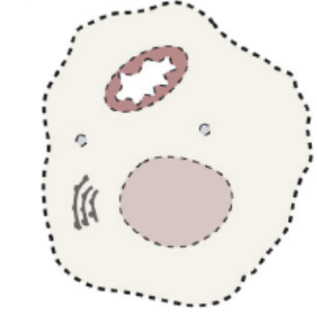
Further questions
How can we identify if cells are biocompatible with a structure that has been generated through 3D printing? Calcein-AM and Ethidium homodimer I use and function?
Cytotoxicity
Live-dead cell assays
Calcein AM
Ethidium homodimer I
Notes:
Biocompatibility tests usually examine the cytotoxicity of the material. Measuring how many cells survive contact with the material is done through direct and indirect contact testing or live-dead cell assays. To see how many cells have survived, different staining methods can be used.
In this image, we see cells that have been stained either red or green.
The green dye, or Calcein-AM, is a fluorescent dye used as an indicator of cell health. When its acetoxymethyl ester group is intact, this dye is not fluorescent. Only when it is affected by nonspecific esterases in healthy, living cells does it begin to glow. The strength of the emitted light is proportional to cell vitality, as esterase activity decreases in cells with lower vitality.
The red dye, or ethidium homodimer I, is highly positively charged, it cannot cross cell membranes to stain living cells. It is thus used to detect nucleic acids in solution or for selectively staining dead cells with damaged plasma membranes.
Knowing all of this, we can infer that the material tested here is most probably biocompatible. This is however further analyzed on the following slides.

Slide 18
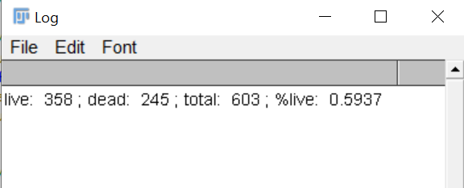
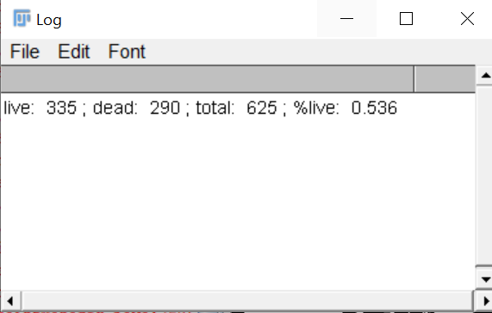
Further questions
Calculate the percentage of dead and alive cells at the top and bottom of the gel
TOP
BOTTOM
Notes:
The structure made with the bioink shown in the previous slide was further tested through a live-dead cell assay, the results of which can be seen on this slide. When comparing these values to the positive and negative controls, it seems that the material is biocompatible. All values have been generated using ImageJ.

Slide 19
Thank you for your attention!
Group 6
Parisa Nabili, Christofer Richard, Hana Roš,
Laura Sanchis Pla, Izar Schärf, Julia Oster

